Slide 1
Towards a next generation influenza vaccine to protect citizens worldwide
Finnian Hanrahan
Infectious diseases and public health
DG Research and Innovation
European Commission
New Delhi
28 August 2018

Slide 2
Burden of flu in Europe, India and the world
Brief overview of Horizon 2020, the European Union’s research funding programme
Previous next-generation influenza vaccine research by the European Union
Overview of call topic
Recommendations

Slide 3
The influenza challenge
10-30% of Europe’s population infected each winter
Hundreds of thousands are hospitalised
15,000-70,000 die in Europe each year

Slide 4
The influenza challenge
Huge burden of flu in India, with repeated H1N1 outbreaks in recent years
Globally around 500,000 deaths each year
Constant threat of new pandemic, eg. avian flu
Limited effectiveness of existing influenza vaccines

Slide 5
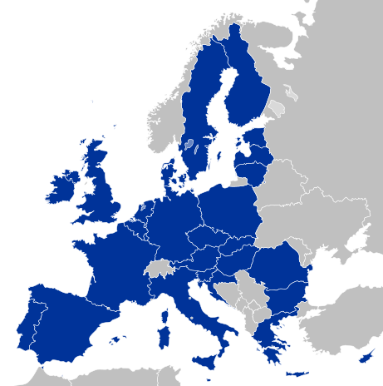
Horizon 2020
The European Union’s largest Research and
Innovation programme ever
€80 billion between 2014-2020
(Rs 65 lakh crore)
Open to the World: international
participation is crucial to solve
research challenges

Slide 6
Previous next-gen influenza vaccine research
In 2013 five projects were funded (total €25 million / Rs 203 crore)

Slide 7
The need for new funding
With these projects coming to an end, a meeting was held in June 2017 to evaluate the field
The five EU-funded projects had made considerable progress, including two phase IIb trials in Europe
However, flu is still a very large danger; the need for more work towards a next generation vaccine is clear

Slide 8
Europe and India fighting flu together
Flu is a fundamentally global challenge
Developing a next-generation vaccine is complex and needs the greatest researchers
Thank you to the Department of Biotechnology for joining us in this effort!

Slide 9
Towards a next generation influenza vaccine to protect citizens worldwide – an EU-India collaboration

Slide 10
Scope 1/4
Human vaccine
“improved efficacy and safety, duration of immunity, and reactivity against an increased breadth of influenza strains”
“at least pre-clinical and/or early clinical research”

Slide 11
Scope 2/4
“include validation of one or more candidate vaccine(s) in a human challenge model of influenza,”
“and/or work to improve the influenza human challenge model itself”

Slide 12
Scope 3/4
“suitability of the interventions to be developed should be addressed and assessed for different population groups, as should the suitability of the candidate(s) to low- or middle-income settings”
“The downstream constraints for the uptake of the intervention by national health systems should be taken into account.”

Slide 13
Scope 4/4
“Proposals should include participants from a variety of different disciplines.”

Slide 14
Expected Impact 1/3
“Further the development of a vaccine that could be effective against an increased breadth of seasonal strains and/or from the outset of a large-scale influenza pandemic.”
“Utilisation of and/or further improvement of the human challenge model of influenza as a tool for candidate vaccine(s) assessment.”

Slide 15
Expected Impact 2/3
“Contribute to the reduction of the burden of influenza outbreaks worldwide, particularly in Europe and India. Contribute to the achievement of Sustainable Development Goal 3, to ensure health and well-being for all, at every stage of life.”

Slide 16
Expected Impact 2/3
“Specific to India, boost initiatives like the National Health Mission and Biopharma Mission [Innovate in India (I3)] of the Government of India by developing affordable biopharmaceuticals, including vaccines, for citizens the world over.”

Slide 17
Helpful references
UN Sustainable Development Goal 3
https://sustainabledevelopment.un.org/sdg3
Human Challenge Trials for Vaccine Development: regulatory considerations, World Health Organization
www.who.int/biologicals/expert_committee/Human_challenge_Trials_IK_final.pdf
National Health Mission, Government of India
www.nhm.gov.in/nhm.html
Innovate in India (i3), Government of India
www.dbtindia.nic.in/press-release-for-launch-of-national-biopharma-mission

Slide 18
Final recommendations
Read the call text carefully
Note deadline – 16 April 2019, 17:00 Belgian time
Evaluation of proposals is by independent experts, not by European Commission or Department of Biotechnology
So seek the advice of colleagues or others in the field

Slide 19
EU Delegation in India
Available to help with questions
delegation-india-ri@eeas.europa.eu

Slide 20
Thank you to the Department of Biotechnology, Ministry of Science & Technology

